Slide 1
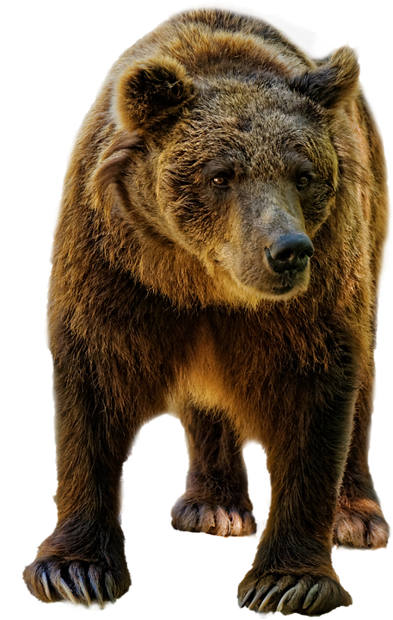
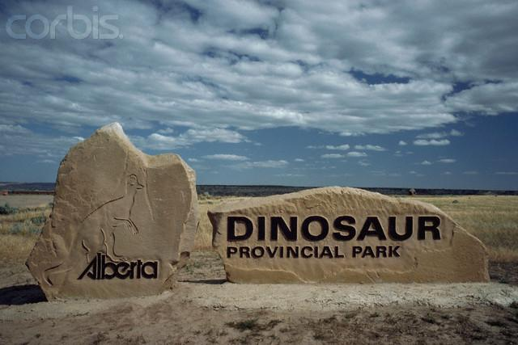
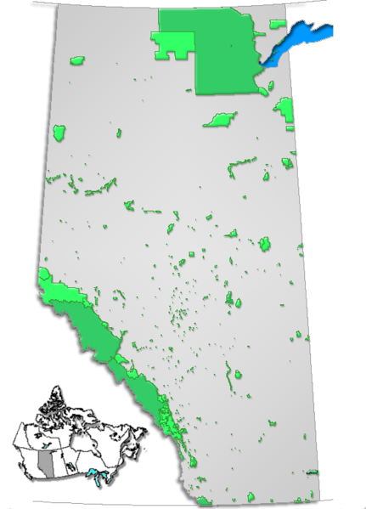
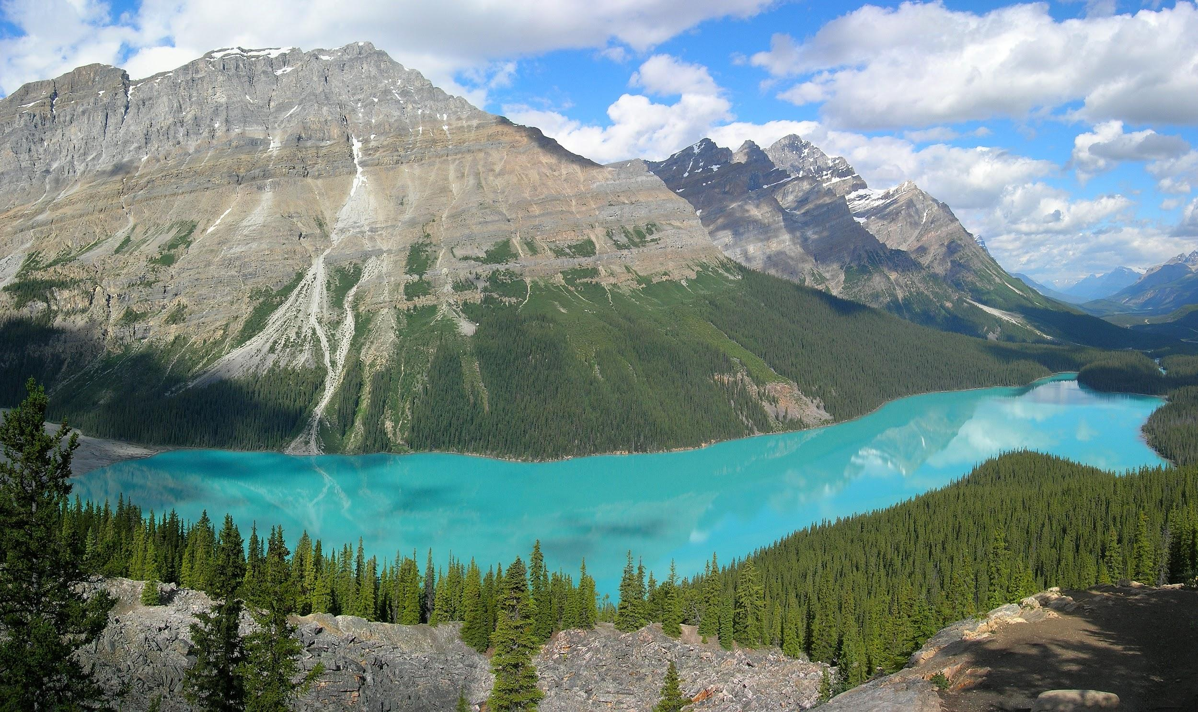
Alberta Parks
Replace all images in this brochure with different images of your park showing elements that are specific that park.
Name the park in this space. Be sure to either delete or type over the instructions in each space.
How can I contact this park?.
Phone number
Website
Mailing address
Facebook
Twitter
Created by Student #1, Student #2, Student #3
Notes:
Teach students to replace images (right click on image) rather than having to crop all photos.

Slide 2
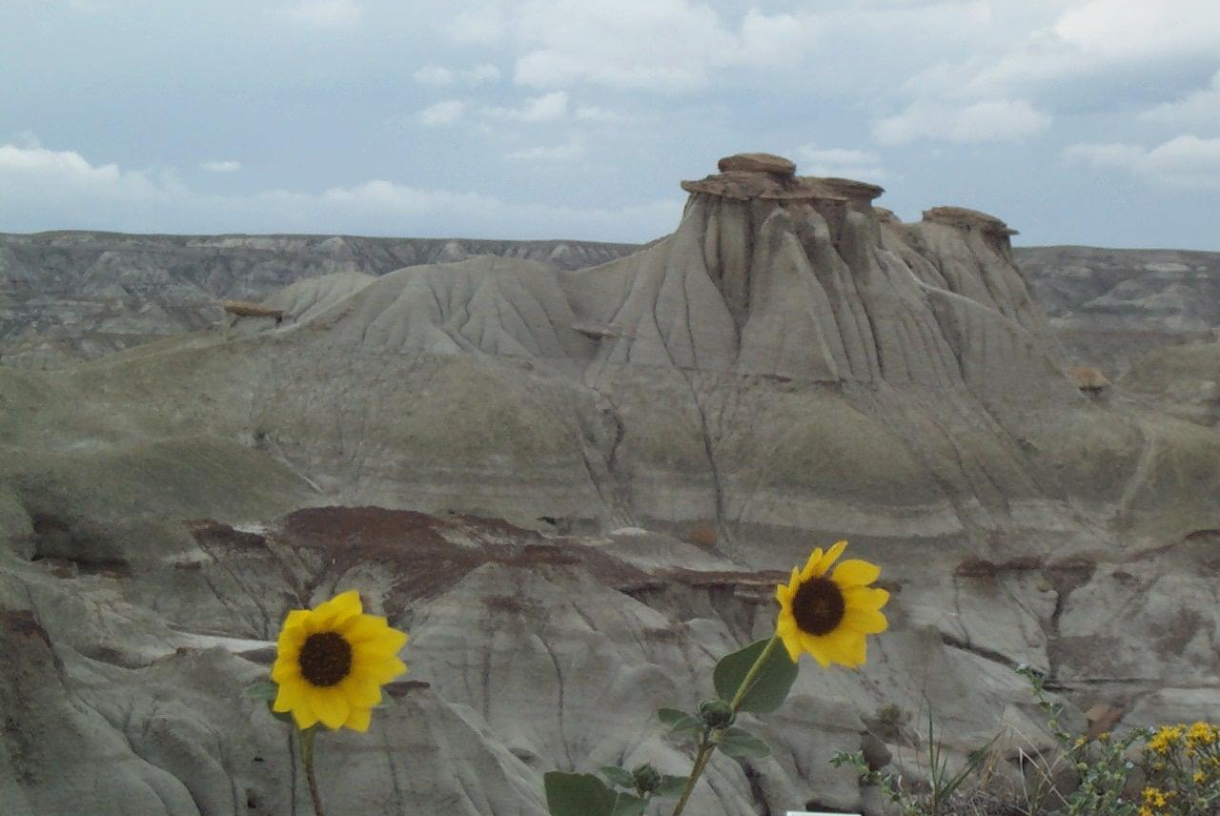
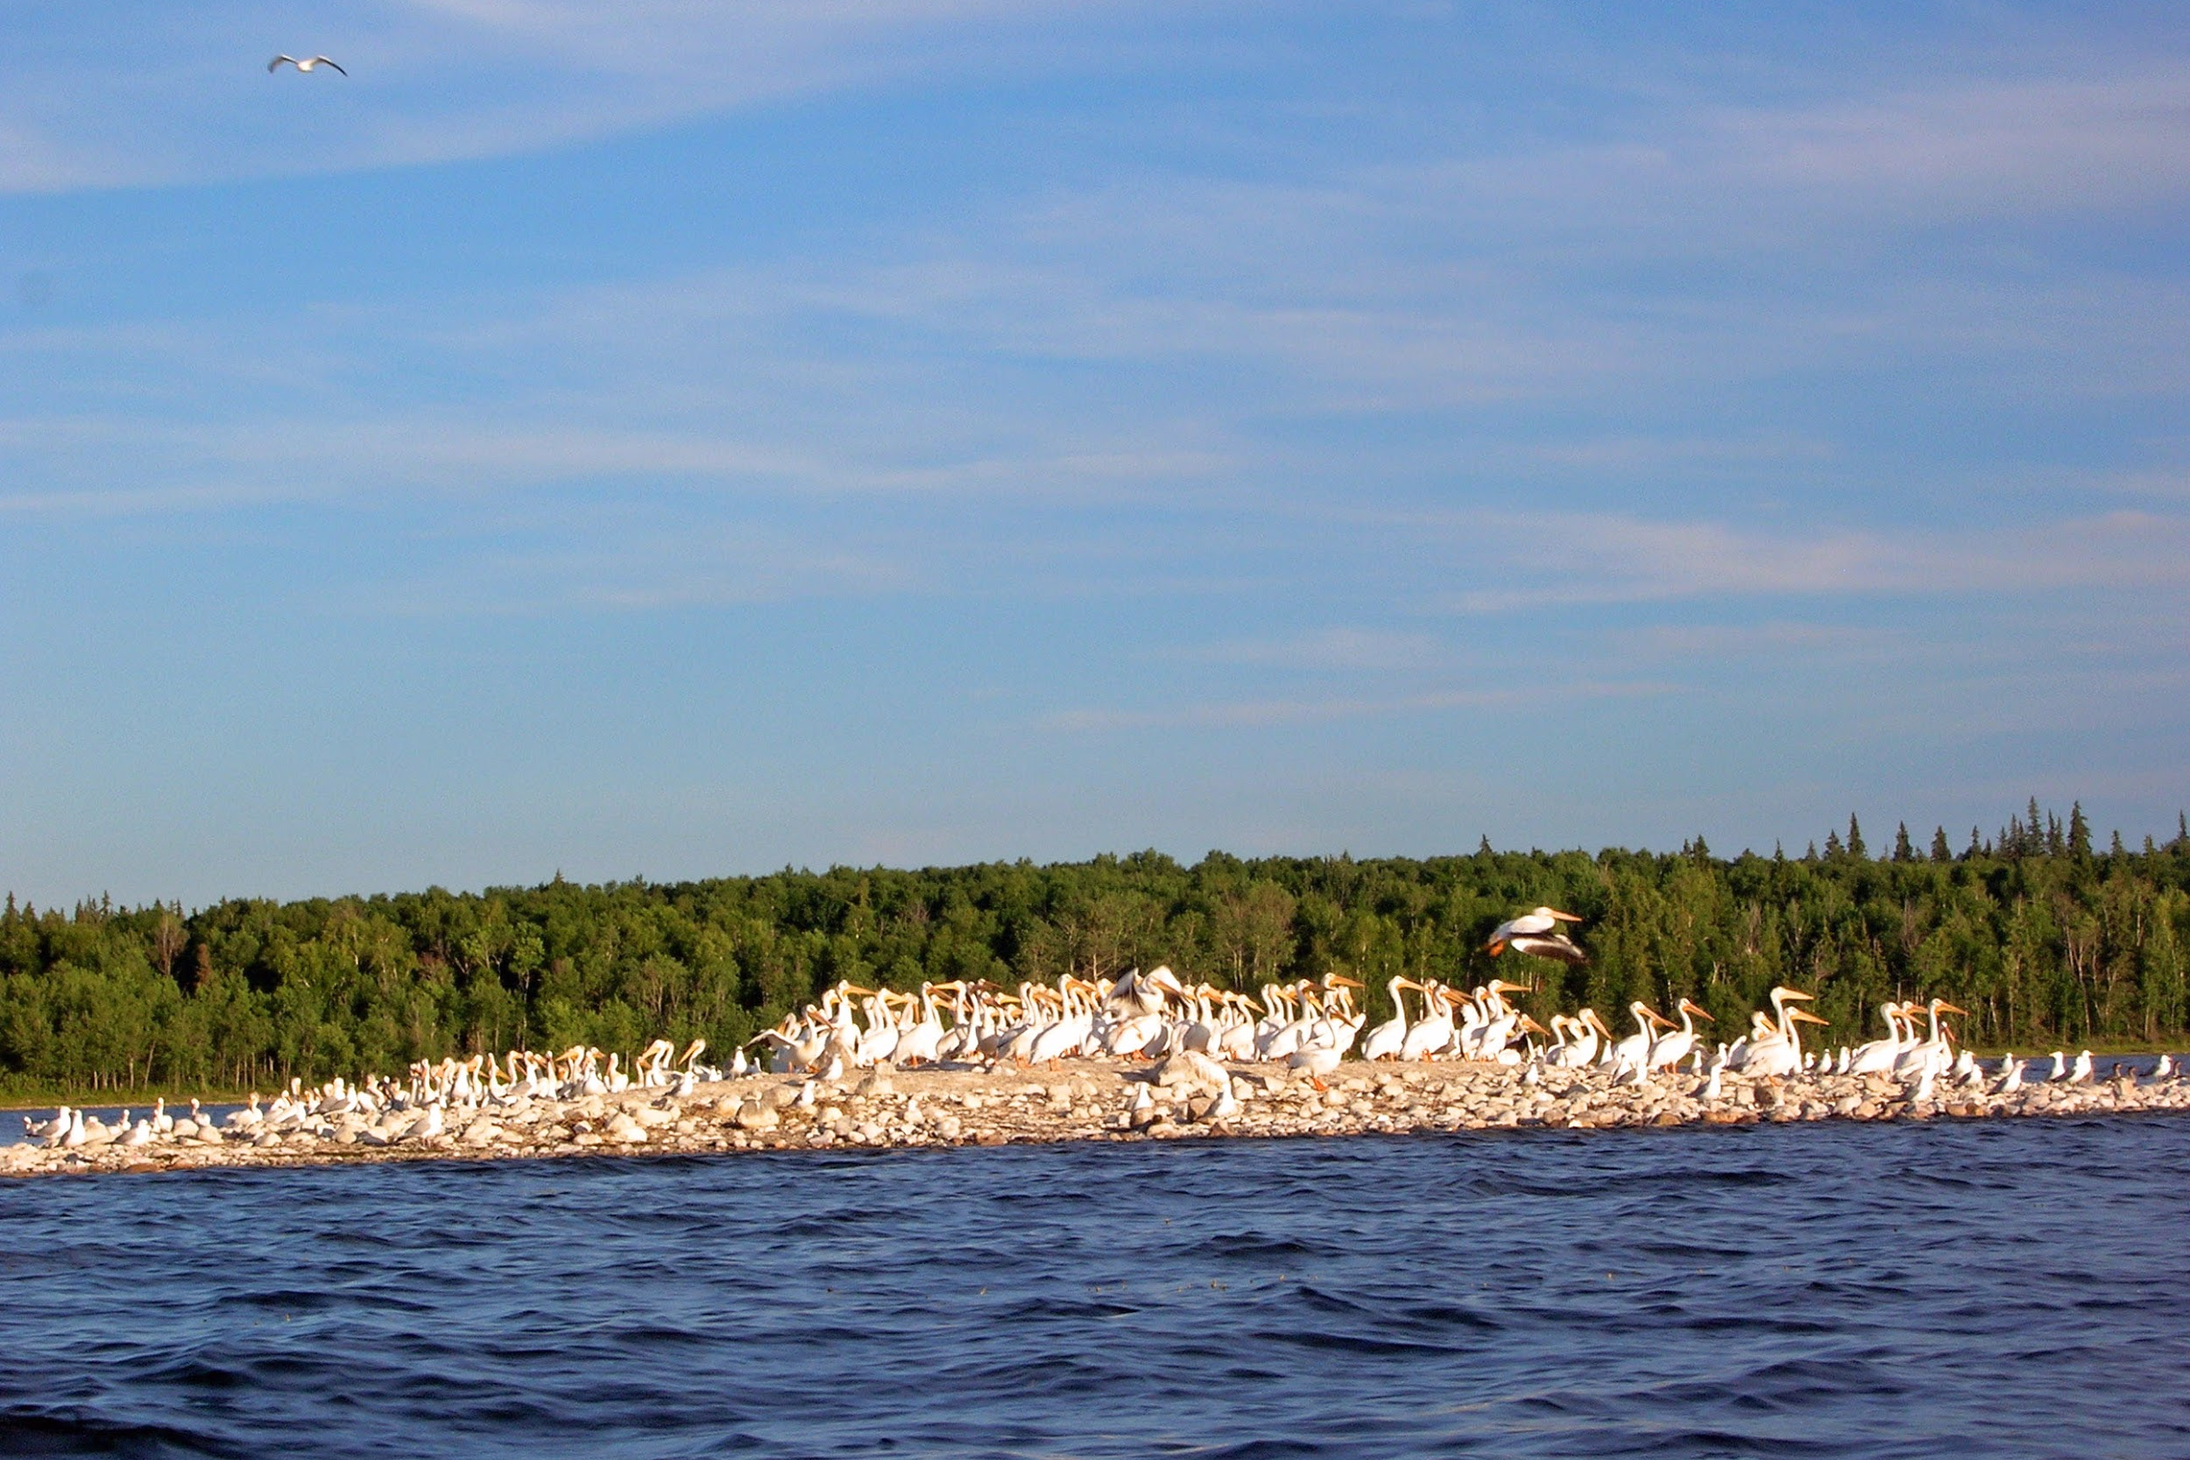
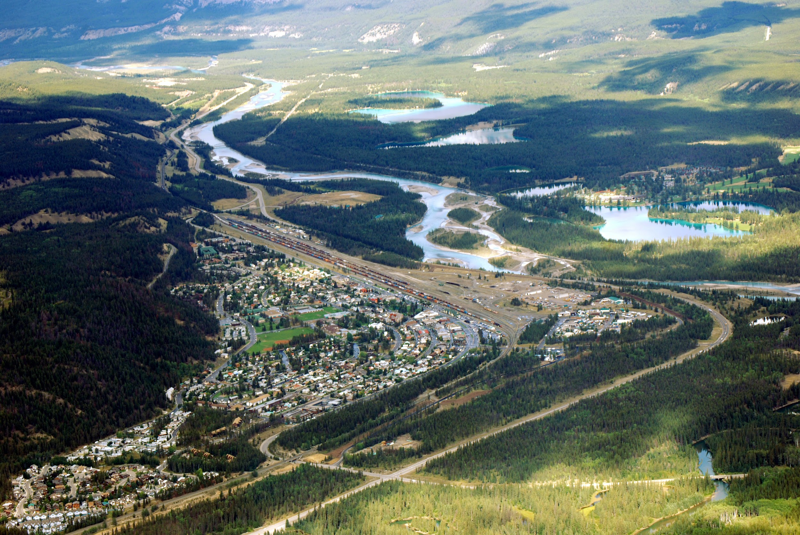
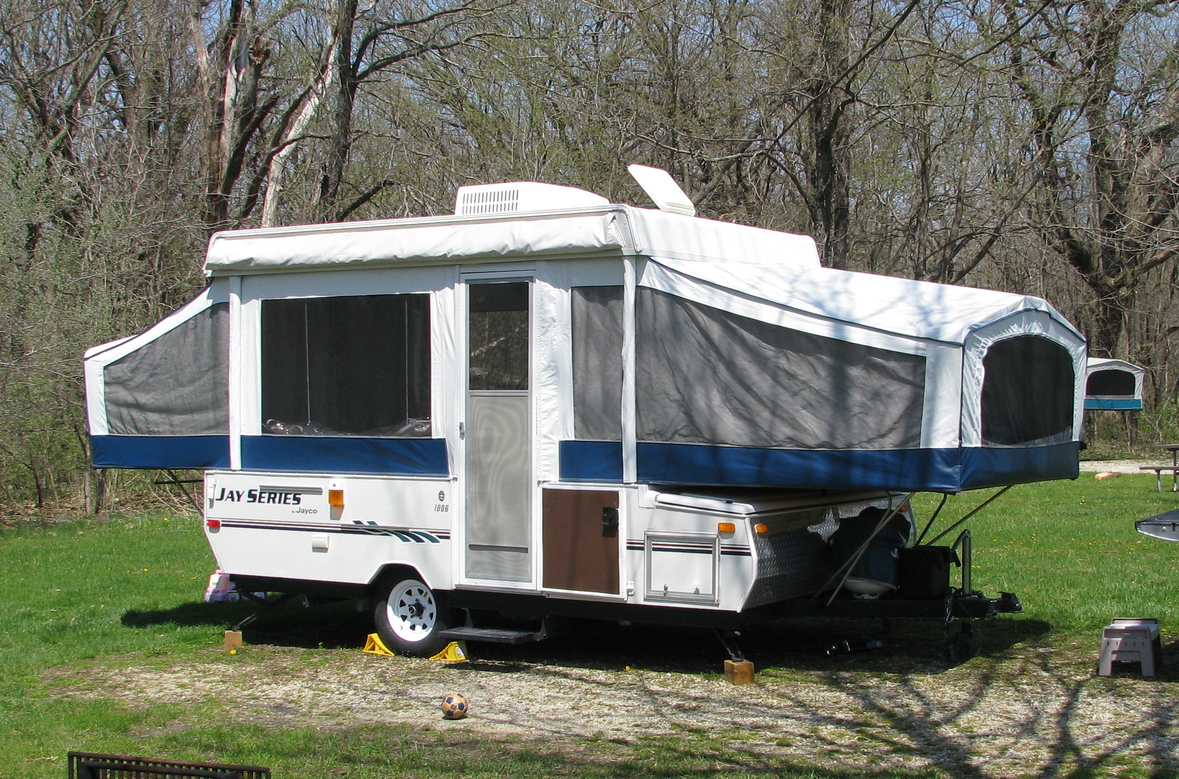
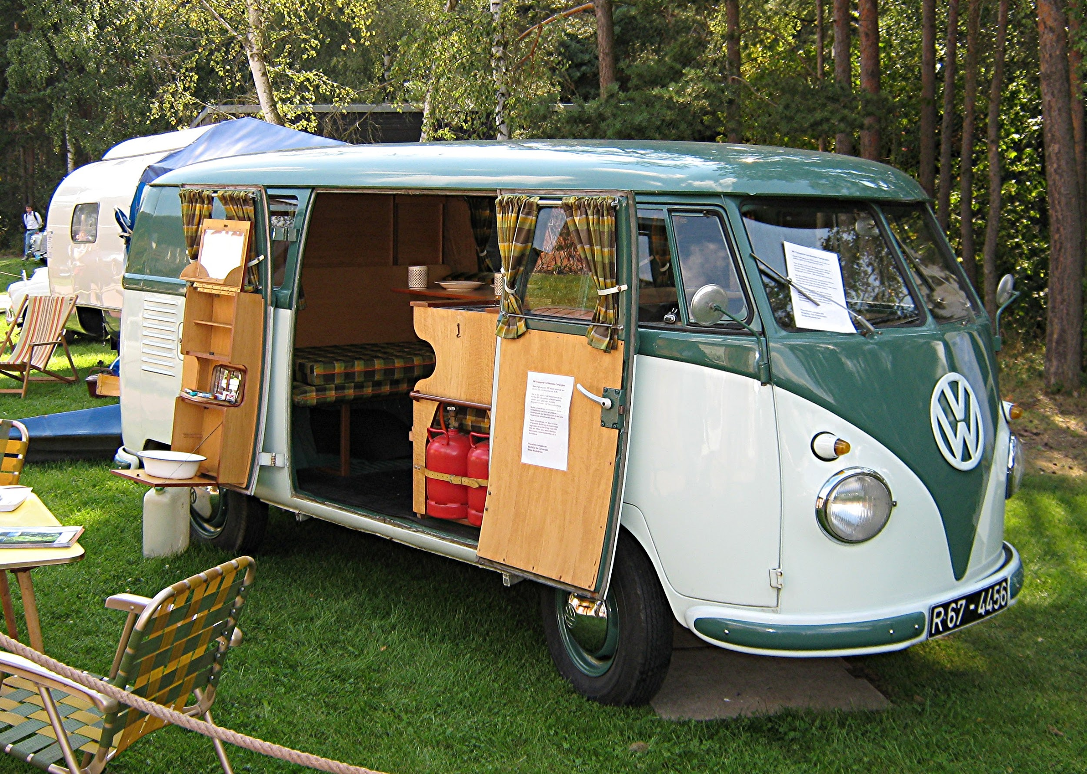
What can I do here? Is this a park that offers comfort camping? Why would you suggest people visit this park?
Why is this a National Park?
Explain why your park has been designated as an area to be preserved and protected.
How does this park continue to help to protect Alberta’s natural environment?
How does the local community benefit from this park?
How does this park help people feel connected to the land?

